Slide 1
Building Brain V.4
Senior Project Final Presentation
Sprint 2016
Team: Emmanuel Vinas, Justin Fletcher
Owners: Ali Mostafavi, Leonardo Bobadilla
Instructor: Masoud Sadjadi
School of Computing and Information Sciences
Florida International University
3/7/16

Slide 2
Problem Definition
Current System:
Android Application.
Tracks energy usage (electricity, lighting, temperature).
Discourages energy waste through interventions and gamification.
Current System Doesn’t Have:
A Building To Integrate With.
Hardware is too expensive.
Installation is too time consuming.
Testing is directly affected.
Our Goal:
Simulated Building.
Lighting, Appliances, Temperature.
User Interaction and feedback.
VR
Simulated Application
App notifications and responses.
Challenges, points.
Cheap and Speedy Testing.
Easy to change building layout.
Time scaling.
Create once, use over and over.

Slide 3
Project Management
 | Week 1 | Week 2 | Week 3 | Week 4 | Week 5 | Week 6
Sprint 1
Energy Usage
UI For EUO - Turn on/off
Sprint 2
Time Tracking
Adjust Time Scale
HUD
Sprint 3
Plug Load HW Sim
UI For Plug Load
Notes:
gantt chart goes here. left side is sprints and stories.top side is dates.

Slide 4
Requirements - User Stories
Energy Usage
UI For Energy Using Objects
Time Tracking
Time Scale
HUD (Heads Up Display)
Plug Load HW
UI For Plug Load

Slide 5
Requirements - User Stories - Energy Usage
Description:
As a User, I would like to be able to have objects that use energy, so that I can record that energy usage in the future and when not plugged, be able to use battery power, if they have a battery.
Acceptance Criteria:
Be able to add Script to an empty game object and have it start consuming energy.
be able to display the usage from all energy using objects, based on it’s values.
Add a battery to an energy using object.
Charge and deplete the battery if the object is not plugged in.
Shut off if it is unplugged and/or battery power is all gone.

Slide 6
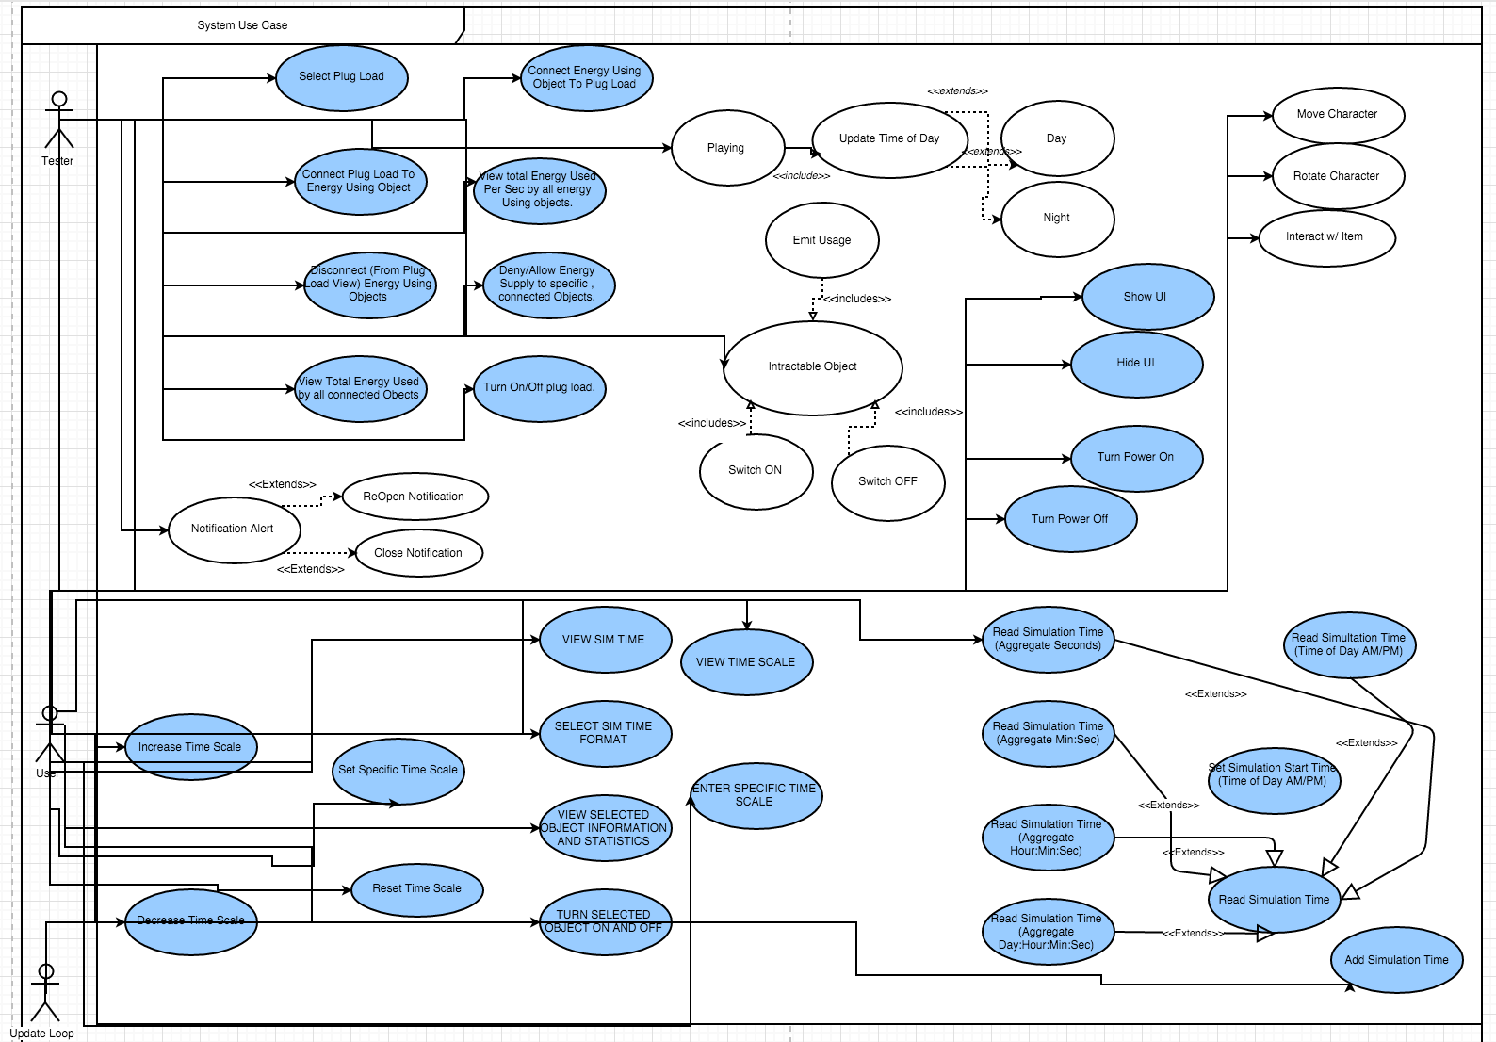
Requirements - Use Cases
There are a lot.
I did the blue ones.

Slide 7
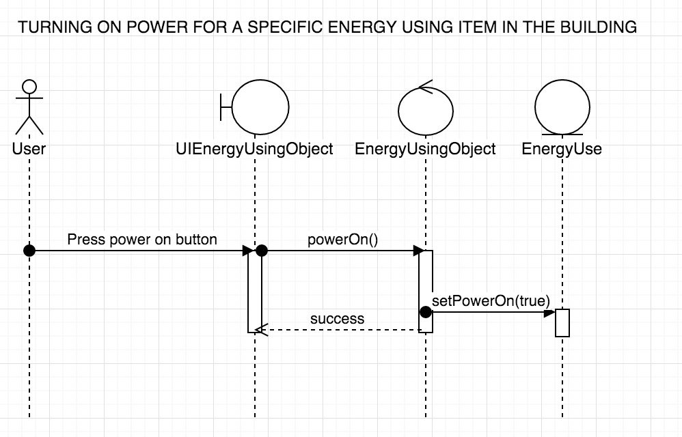
Sequence Diagram: Turn Power On

Slide 8
System Design - Architecture - Unity
Simulation Assets
Our Components
Other Assets
UNITY
GAME
ENGINE
View Scripts
3D Models / Textures / Audio
Controller Scripts
Unity Components
Modal Scripts
Game Objects (Entities)
Notes:
We implement MVC, we take advantage of Unity

Slide 9
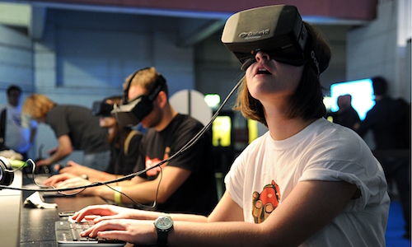
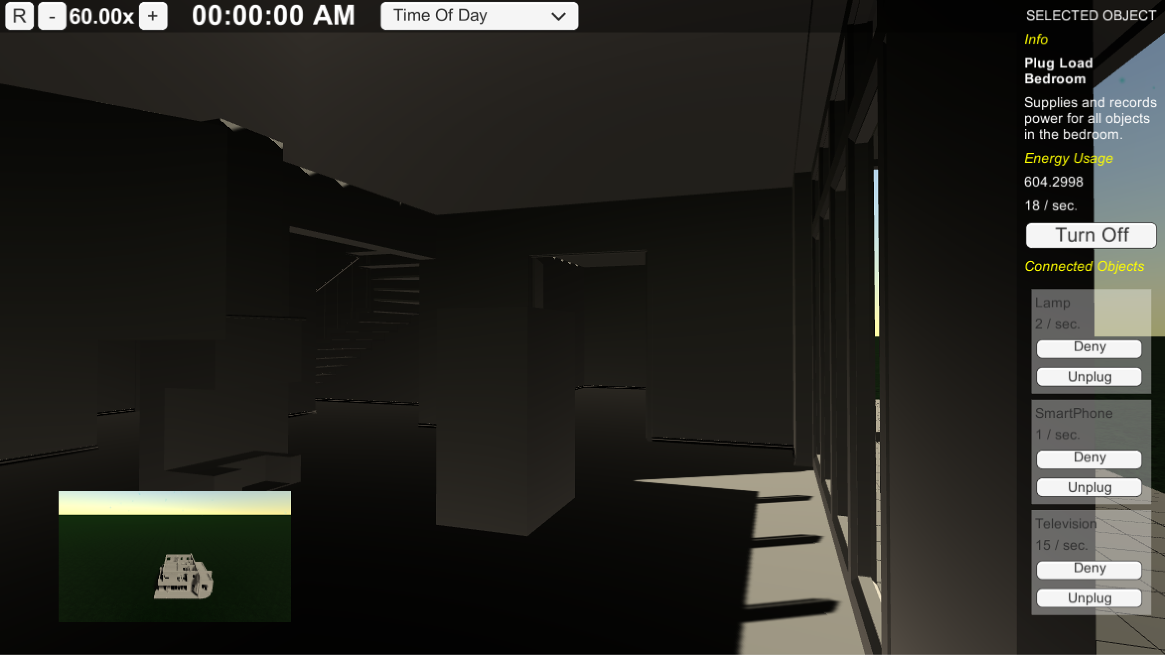
System Design - Deployment
Local Machine
Local Storage:
Saving Data / Statistics for each simulation
Simulation Program:
Series of scripted events
Reaction to user input
User feedback
User Interaction:
Mouse, Keyboard, Controller, Oculus.
_
_
_

Slide 10
System Design - Deployment
Persistent Data
Not Implemented … Yet.
How to implement?
SQLite
Text Files / Json
Scriptable Objects

Slide 11
Minimal Class Diagram
TimeScale
NotificationView
NotificationModel
DayNightController
TimeScaleController
Observes
Time
TimeTracker
NotificationController
<<extends>>
<<extends>>
Uses
<<extends>>
User View
<<extends>>
TimeTrackerController
<<extends>>
<<extends>>
Transform
<<extends>>
MonoBehaviour
Observes
Time
<<extends>>
<<extends>>
HUDView
HUD
CharacterController
<<extends>>
<<extends>>
<<extends>>
<<extends>>
<<extends>>
<<extends>>
<<extends>>
SimObject
Displays
HUDController
UIEnergyUsingObject
<<extends>>
<<extends>>
<<extends>>
<<extends>>
EnergyUsingObject
PlugLoadController
EmissionController
Plugged In
Battery
EnergyUsage
PlugLoadView
PlugLoad
EmissionTracker
EmissionView
Notes:
design patterns (entity - component used in unity), layer of abstraction with SimObject and extending that based on necessary functionality, observer pattern using events.

Slide 12
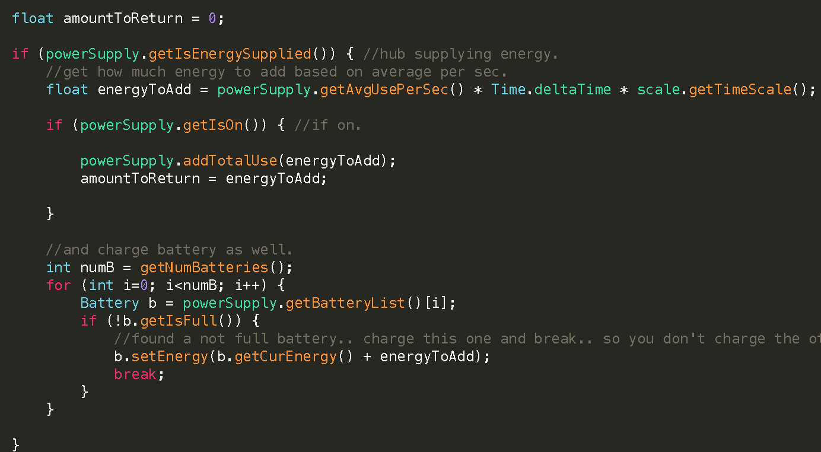
Energy Recieve Algorithm
ENTRY CONDITION :
Is energy being supplied?
Calculate how much energy should be used this frame.
Is the power on?
Use the calculated amount.
For every battery
Find the first non-full battery
Give it charge.

Slide 13
Test Case - TimeTracking_001
TestID | TimeTracking_001
Objective | SetSimulationStartTime interprets the string parameter correctly into an int which should be the number of seconds in the specified time, given the strings format being “00:00:00 AM”
Steps | Call the method providing a random time as the string such as “10:06:07 AM” Print the current time to prove that the current time of day in the simulation is the provided start time + the time that the simulation has been running. The repeat steps 1 and 2 providing PM as the last two characters in the string, then stop.
Expected Results | The method should correctly interpret the string, converting hours to seconds, then minutes to seconds, then adding all seconds together. It should correctly differentiate AM from PM, adding 12 hours worth of seconds if PM is there instead of AM.

Slide 14
Summary
Building cool and fun simulation:
Test the effectiveness and capabilities of the Building Brain android App in a controlled environment.
Contact Info:
Justin Fletcher - JFlet013@fiu.edu
Any Questions?
Thank you!

